Slide 1
FULL STACK DEVELOPMENT COURSE
DAY 01
IRFANSJAH
irfansjah@gmail.com
081293728732

Slide 2
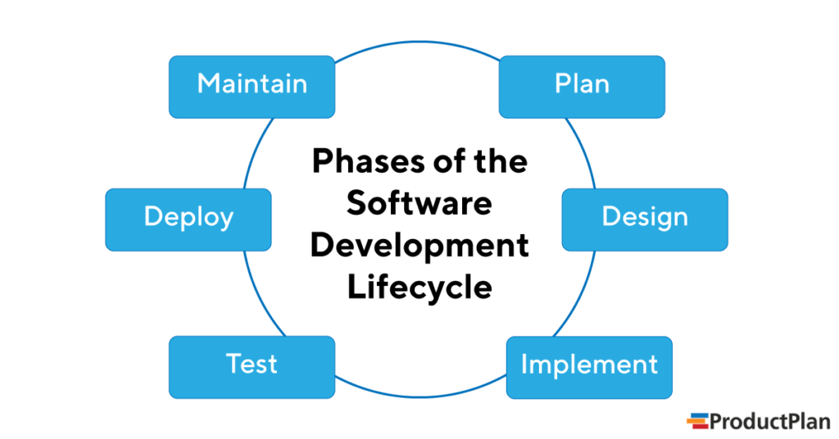
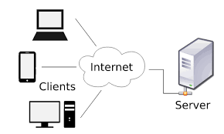
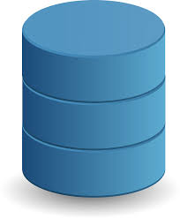
What is FULL STACK DEVELOPMENT ?
WHAT IS FULL STACK DEVELOPMENT

Slide 3
on-site
CLIENT
off-shore
SOFTWARE DEVELOPMENT TEAMS
PROJECT MANAGER
BUSINESS ANALYST
DESIGNERS
DEVELOPERS
QA'S
FRONTEND
BACKEND
TYPICAL SOFTWARE DEVELOPMENT TEAMS

Slide 4
What is FULL STACK DEVELOPMENT ?
Business Analyst (BA)
This is someone who is responsible for formulating goals, analyzing and documenting the core processes and systems, and ensuring the alignment of business model and technology. BA is all things for everybody. They evaluate what works and what doesn’t work and set the direction for business development.
Project Manager (PM)
This person is in charge of planning and execution. PM is responsible for getting things done. They also take care of building relationships among the client and various organization departments. PMs oversee all the processes, delegate the tasks among other team members, and ensure that everyone stays on track.
UX Designer
This is someone who designs the way users will interact with the product. They ensure that all the features solve people’s problems and fulfill business goals. Namely, they determine how the product will look and how it will work. The main focus of a UX designer is functionality and usability.
Developers (Front-end/ Back-end)
These are the people who do the actual coding. Whereas front-end developers work on the customer-facing elements of the product, back-end developers take care of its functionality, which is everything the user doesn’t see.
Quality Assurance Engineer (QA)
This is someone who tests the product to make sure that it works well, meets the quality standards and client requirements. QA is like a final editor with meticulous attention to the smallest detail. They detect errors and bugs early on so that the team can fix it before it gets to the users.

Slide 5
MODULES
MAIN PROGRAM
MAIN PROGRAM
MAIN PROGRAM
MODULES
UI
MODULES
MODULES
MODULES
DB
APPLICATION STRUCTURE BREAKDOWN

Slide 6
UI LANGUAGE
MAIN PROGRAM
UI
USAGE OF LAYOUT LANGUAGE
XML BASED HTML, XAML, ETC
TEMPLATE BASED LAYOUT
APPLICATION STRUCTURE BREAKDOWN

Slide 7
PROGRAMMING LANGUAGE
MODULES
MAIN PROGRAM
MODULES
MODULES
POPULAR PROGRAMMING LANGUAGE
C and its descendants
C#, PHP, Perl, Java, Kotlin, Javascript,
Pascal and Its Decendants : Pascal, Delphi
Basic and Its Decendants : BASICA, GW Basic, Visual Basic etc
Others : Python etc
MODULES
MODULES
APPLICATION STRUCTURE BREAKDOWN

Slide 8
DATABASE and Data Management
MAIN PROGRAM
Database Type :
Simple Database : Text, Files
SQL Based
No SQL
Popular Database Engine
Simple Database : csv, xml, json file
SQL Based : MySQL, SQL Server, Oracle, PosgreSQL
No SQL : MongoDB, Redis, etc
ORM / ODM Concept
DB
APPLICATION STRUCTURE BREAKDOWN

Slide 9
FRONTEND
BACKEND

Slide 10
STACK ? A tech stack is the complete set of technologies a company uses to build an application. Typically, a stack includes one or more programming languages, libraries, servers, databases, frameworks, and developer tools.
Pinterest’s tech stack consists of:
HTML, CSS, and JavaScript
Python
Java
Go
Django
React
Backbone
Redis
MySQL
nginx
Uber’s tech stack includes:
HTML, CSS, and JavaScript
React
jQuery
Node.js
Python
PostgreSQL
MongoDB
Cassandra
Hadoop
Kafka

Slide 11
In theory, a full stack developer is a coding jack-of-all-trades who has mastered every part of the development stack.
WHAT IS FULL STACK DEVELOPER

Slide 12
REQUIREMENT TO BE A FULLSTACK DEVELOPER
KNOWLEDGE ON FRONT-END DEVELOPMENT
KNOWLEDGE ON BACK-END DEVELOPMENT
KNOWLEDGE ON DATABASE SYSTEM
DEEP UNDERSTANDING WITH WEB ARCHITECTURE
HARD SKILLS
ABILITY TO LEARN NEW TECHNOLOGY RELATED TO APPLICATION DEVELOPMENT
TEAMWORK AND COMMUNICATION
CRITICAL AND LOGICAL THINKING
TIME MANAGEMENT
PROBLEM SOLVING
SOFT SKILLS

Slide 13
TOOLS
APPLICATION REQUIREMENTS
DEVELOPMENT TOOLS
PROJECT MANAGEMENT AND COLLABORATION TOOLS
TOOLS

Slide 14
APPLICATION REQUIREMENTS
COMPILER VS INTERPRETER
PACKAGE MANAGER
DATABASE ENGINE
WEB SERVER
TOOLS

Slide 15
DEVELOPMENT TOOLS
IDE AND CODE EDITOR
WIREFRAME / APPLICATION MOCKUP
CODE REPOSITORY / SOURCE CONTROL
DEPLOYMENT TOOLS
TESTING TOOLS
TOOLS

Slide 16
PROJECT MANAGEMENT AND COLLABORATION TOOLS
WIREFRAME / APPLICATION MOCKUP
PROJECT MANAGEMENT TOOLS AND COLLABORATION TOOLS
TOOLS

